Slide 1
Web Application Development II
Week 11: Vue.js
Routing &
State Management

Slide 2
Agenda
Composables
What is State Management?
What Pinia Provides
Running Example
Setting Up
Defining / Using a Store
Routing
Learning Outcomes
By the end of this lesson, you can:
Explain why SPAs need state management
Create Pinia stores (state, getters, actions)
Share state across components
Implement async actions with store’s states and actions
Implement route guards based on a store
Handle loading/error states properly

Slide 3
(Optional) What is Composable?
Example: composables/useCounter.js
  import { ref, computed } from 'vue'
  export function useCounter(initialValue = 0) {
  // 1. Reactive State
  const count = ref(initialValue)
  // 2. Computed Properties
  const doubleCount = computed(() => count.value * 2)
  // 3. Methods / Actions
  function increment() {
  count.value++
  }
  function decrement() {
  count.value--
  }
  function reset() {
  count.value = initialValue
  }
  // 4. Return reactive state and methods
  return { count, doubleCount, increment, decrement, reset }
  }
A composable is a function that leverages Vue's Composition API to encapsulate and reuse stateful logic.
Think of it as a self-contained module of reactive state (ref, reactive), computed properties, and methods.
Key Characteristic: Unlike standard utility functions that only perform stateless calculations (e.g., formatting a date), composables manage reactive data over time.

Slide 4
(Optional) Usage of Composable
Example: Components/CounterWidget.vue
<script setup>
import { useCounter } from '../composables/useCounter'
// Destructure reactive state and methods
const { count, doubleCount, increment, decrement, reset } = useCounter(10)
</script>
<template>
<div class="counter-card">
<h2>Counter Demo</h2>
<p>Current Count: <strong>{{ count }}</strong></p>
<p>Double Count: <strong>{{ doubleCount }}</strong></p>
<div class="actions">
<button @click="increment">+1</button>
<button @click="decrement">-1</button>
<button @click="reset">Reset</button>
</div>
</div>
</template>
A composable is a function that leverages Vue's Composition API to encapsulate and reuse stateful logic.
Think of it as a self-contained module of reactive state (ref, reactive), computed properties, and methods.
Key Characteristic: Unlike standard utility functions that only perform stateless calculations (e.g., formatting a date), composables manage reactive data over time.

Slide 5
What is State Management?
Technically, every Vue component instance already "manages" its own reactive state.
State: data that affects what the UI displays
Examples:
logged-in user + token
cart items + quantities
products list from API
loading/error flags
Key idea: State changes → UI updates automatically.
Example: a simple counter component
  <script setup>
  import { ref } from 'vue'
  // state
  const count = ref(0)
  // actions
  function increment() {
  count.value++
  }
  </script>
  <!-- view -->
  <template>{{ count }}</template>

Slide 6
The Problem without a Store (Prop Drilling)
In a SPA, many components need the same data.
If you store data only in a parent component and pass state through props across many layers could create prop drilling and makes code harder to maintain.
For example, in a shopping cart, if you store cart data in a parent component:
Navbar needs cart count
Product Card needs “add to Cart”
Cart page needs totals and actions
Without a store, you must pass props/events through many layers:
messy
hard to refactor
difficult to share across routes
This is why we use state management.
A store (Pinia) provides a central source of truth.

Slide 7
What Pinia Provides
Pinia = official Vue store library (recommended for Vue 3)
A store (Pinia) provides a central source of truth. It has three concepts
state: shared reactive data
getters: derived values (like computed)
actions: methods (sync or async) to update state
equivalent of data, computed, and methods in components
Without a store, you must pass props/events through many layers:
messy
hard to refactor
difficult to share across routes
This is why we use state management.

Slide 8
When Should You Use a Store
A store should contain data that can be accessed throughout your application. This includes data that is used in many places.
For example
  user information that is displayed in the navbar
  data that needs to be preserved through pages in a very complicated multi-step form.
  In our running example (see next slides), products go in a store because products list may be reused by many views (products page, details page, etc.)
On the other hand, you should avoid including in the store local data that could be hosted in a component instead, e.g. the visibility of an element local to a page.
Not all applications need access to a global state, but if yours need one, Pinia will make your life easier.

Slide 9
Running Example (1)
As a running example to understand state management concepts, we shall use an e-commerce-style mini app where multiple pages/components need the same shared state.
Observe the codes given in the resource folder.
Same state used in many places (navbar cart page, product page)
Derived state (getters) (cart item count, total price)
Actions (add/remove item, checkout, login/logout)
Persistence (save cart/user to localStorage)
Async actions (load products from your Express API)

Slide 10
Running Example (2)
MiniShop sells a small list of products. Users can:
Browse products
Add products to cart
Change quantities in the cart
See cart count in the navbar on every page
“Login” to enable checkout
Data Flow
User clicks “Add to cart” → calls cartStore.addToCart(product) → cartStore updates items[]
Navbar reads cartStore.itemCount
Cart page reads cartStore.items and cartStore.totalPrice

Slide 11
Running Example (3)
Pages / Views (Vue Router)
ProductsView (/products)
Lists products, “Add to cart” buttons
CartView (/cart)
Shows cart items, quantities, total, “Checkout”
LoginView (/login)
Fake login to demonstrate auth store + route guards
Components (reusable)
NavBar.vue → shows cart count + login status
ProductCard.vue → product + add button
CartItemRow.vue → quantity controls per item

Slide 12
Running Example (4)
Pinia Stores (State Management)
useProductsStore (data + async)
  State:
  products: []
  loading, error
  Actions:
  fetchProducts() (async GET request to Express API)
useCartStore
  State:
  items: [ { productId, title, price, qty } ]
  Getters:
  itemCount (sum of qty)
  totalPrice
  isEmpty
  Actions
  addToCart(product)
  removeFromCart(productid)
  increaseQty(productId)
  decreaseQty(productid)
  clearCart()

Slide 13
Running Example (5)
Pinia Stores (State Management)
useAuthStore (data + async)
  State:
  user: null or { username }
  token: ‘fake-token’ value that represents authentication
  loading, error
  Getters:
  isLoggedIn
  Actions:
  login(username, password) : async POST request to Express API
  logout

Slide 14
Setting Up (1)
We need to setup both the backend and the frontend, for this running example.
FrontEnd (resource folder): MiniShop app
Download resource folder and run the following commands in the terminal:
  cd resource
  pnpm install
  pnpm dev
BackEnd (server/products folder): API Mockup using Node.js + Express.js
It provides 3 APIs:
GET /products # return a list of products
POST /login # Mockup login that accepts any username/password
POST /checkout # Mockup checkout
Download server.zip and unzip. Run the following commands in the terminal:
  cd server/products
  pnpm install
  pnpm dev

Slide 15
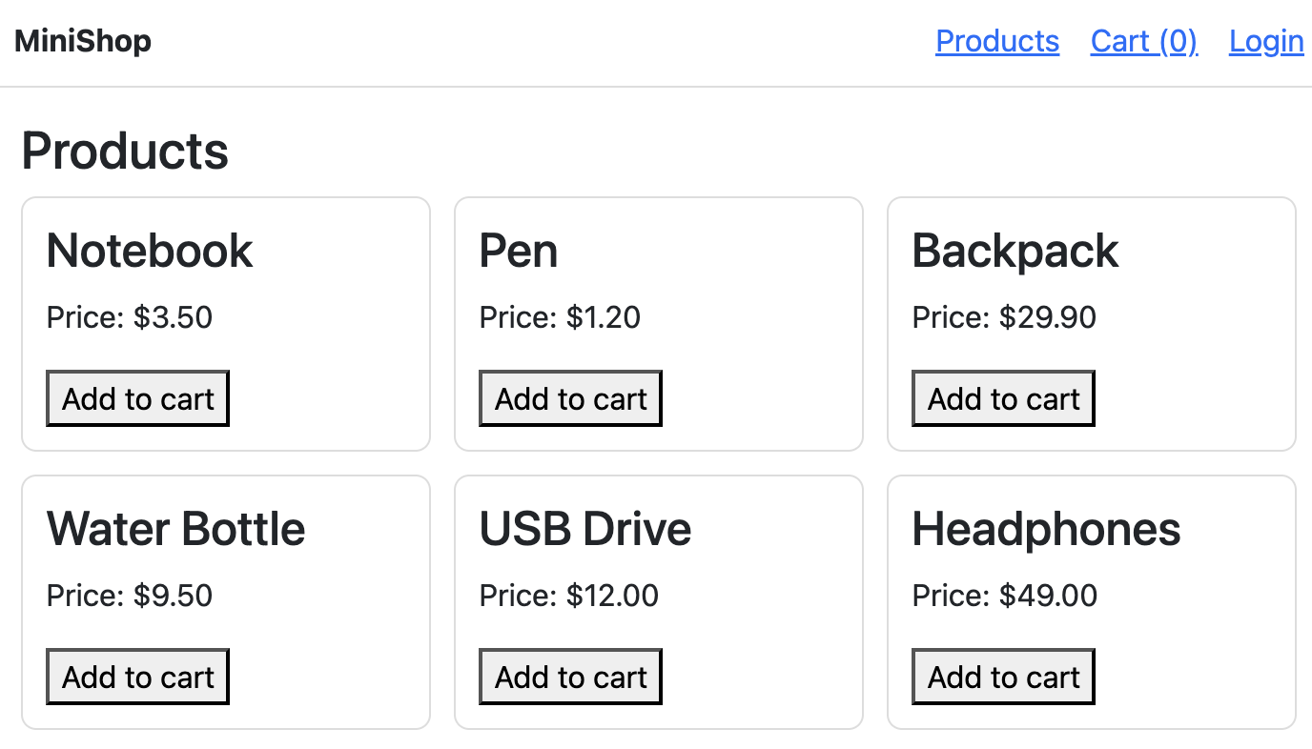
Setting Up (2)
If correctly setup, visiting the MiniShop website should see the following result:
Note that the product data is queried from the backend server.

Slide 16
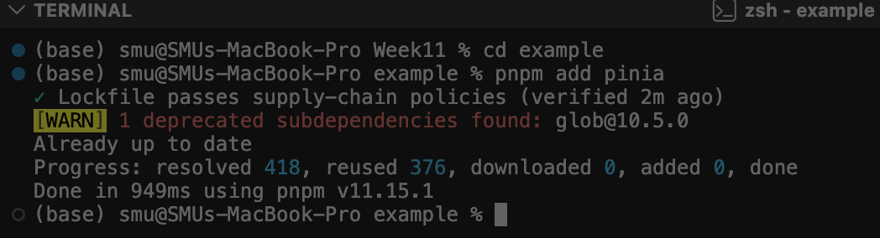
Pinia Setup
Install pinia
In the terminal, go to the Vue project where you wish to use pinia and run.
pnpm add pinia
Import & Use Pinia
Example main.js
  import { createApp } from 'vue'
  import { createPinia } from 'pinia'
  import App from './App.vue'
  import router from './router'
  const app = createApp(App)
  app.use(createPinia())
  app.use(router)
  app.mount('#app')

Slide 17
Defining a Store
A store is defined using defineStore() and that it requires a unique name, passed as the first argument:
Example products.js
import { defineStore } from 'pinia'
export const useProductsStore = defineStore(‘products’,
() => {
// setup store => define states, getters, actions
})
You can name the return value of `defineStore()` anything you want,
but it's best to use the name of the store and surround it with `use`and `Store`
E.g. `products.js` => `useProuctsStore`
The first argument is a unique id of the store across your application.
The second argument setups the store.

Slide 18
Setup the Store
When defining a store, we can pass in a function that defines reactive properties and methods and returns an object with the properties and methods we want to expose.
ref => state
computed => getter (refer to cart.js for an example)
function => action
Example products.js
export const useProductsStore = defineStore('products', () => {
// state
const products = ref([])
…
// action
async function fetchProducts() {
…
const response = await axios("http://localhost:8000/products");
products.value = response.data;
…
}
return { products, …, fetchProducts }
})
You must return all states/actions/getters; otherwise your app may break

Slide 19
Using a Store
We have defined the store but the store won't be created until use...Store() is called within a component <script setup>
Example: ProductsView.vue
<script setup>
import { onMounted } from "vue"
import { useProductsStore } from "@/stores/products"
import ProductCard from "../components/ProductCard.vue"
const productsStore = useProductsStore()
onMounted(() => {
if (productsStore.products.length === 0) {
productsStore.fetchProducts();
}
});
</script>
‘@’ is the alias for the src folder. It tells the bundler (Vite) to start looking directly from the src folder
Similar to ref(), stores are reactive.
Access productsStore’s fetchProducts() action to fetch products when the component is mounted.

Slide 20
States: Accessing the State Property
You can directly read from and write to the state by accessing it through the store instance.
Example: CartView.vue
<script setup>
import { useCartStore } from "../stores/cart";
const cart = useCartStore();
const totalFormatted = computed(() => `$${cart.totalPrice.toFixed(2)}`);
</script>

Slide 21
States: in Template
We can also use the state property in Template in a similar way to properties defined via ref()
Example: ProductsView.vue
<template>
…
<ProductCard
v-for="p in productsStore.products"
:key="p.id"
:product="p"
/>
…
</template>
This is a component
Access productsStore’s products (state property)

Slide 22
States: for Data Binding
We can use the state property for data binding (v-bind, v-model)
Example
<script setup>
…
const store = useStore()
store.count++
…
</script>
<template>
<input v-model="store.count" type="number" />
</template>

Slide 23
Getters: Computed Property
Getters are exactly the equivalent of computed values for the state of a Store.
So you use them like a computed property
Example cart.js
export const useCartStore = defineStore('cart', () => {
// states
const items = ref([])
// getters
const itemCount = computed(() => items.value.reduce((sum, i) => sum + i.qty, 0))
const totalPrice = computed(() => items.value.reduce((sum, i) => sum + i.price * i.qty, 0))
const isEmpty = computed(() => items.value.length === 0)

Slide 24
Actions
Actions are the equivalent of methods in components. They are defined like defining a function in JavaScript.
They typically define business logic, e.g., ”give a discount when the order is > $50”.
Example cart.js
export const useCartStore = defineStore('cart', () => {
…
// actions
function removeFromCart(productId) {
items.value = items.value.filter((i) =>
i.productId !== productId)
}

Slide 25
Actions: Invoking Actions
Actions are invoked like regular functions and methods:
Example
<script setup>
const store = useCounterStore()
// call the action as a method of the store
store.randomizeCounter()
</script>
<template>
<!– invoke action on the template -->
<button @click="store.randomizeCounter()">
Randomize
</button>
</template>

Slide 26
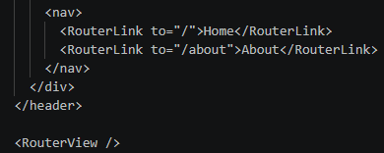
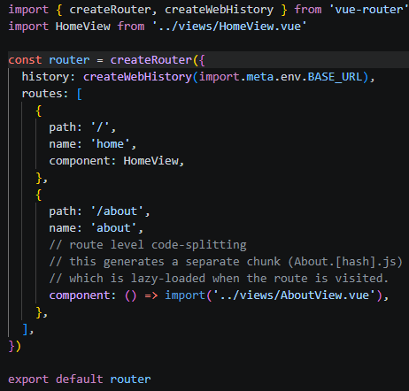
Routing (revisit Week4 lecture)
Check out App.vue and router/index.js in the example app that we created based on the Quick Start slides
App.vue provides a default template which use <RouterView />
This will link to router/index.js
In App.vue or any other component nested in App.vue, use <RouterLink></RouterLink> to map the URL to the specific Vue components. For example,
“http://localhost:5173/about” maps to “AboutView.vue” component, which will be rendered in the <RouterView /> location in App.vue
App.vue
router/index.js

Slide 27
Routing: with Parameter (revisit Week4 lecture)
In the routes, we can pass a parameter.
For example,
  {path: "/products/:id", component: ”ProductsView" }
When the user visits the path, e.g., http://localhost:5173/products/1, the router launches ProductsView component, passing it the parameter id with the value of 1
That is, in ProductsView component, the parameter can be accessed via route.params.id
Example
import { useRoute } from 'vue-router’
// 1. Initialize the route hook
const route = useRoute()
// 2. Read the parameter (Note: route params are always strings)
const userId = route.params.id
Note: this example is from Week 4 Example 10

Slide 28
Routing: Redirect (1) (revisit Week4 lecture)
In routing, we can redirect a given URL to another URL.
For example,
  { path: "/", redirect: "/products" }
When the user visits the root URL / (e.g., http://localhost:5173/), the router automatically redirects to /products
Use case:
Redirect to a default landing page when the user visits the site
Redirect to a login page after user registration
Example router/index.js

Slide 29
Routing: Redirect (2)
Redirect can also be implemented programmatically using router.push(/new_url)
When router.push executes, Vue Router changes the browser's current address path to /new_url and loads the component mapped to that route.
Example components/NavBar.vue
import { useRouter } from "vue-router"
const router = useRouter()
function logout() {
auth.logout();
router.push("/products");
}
After log out, redirect to /products

Slide 30
Routing: Navigation Guard (1)
Navigation guard is code that runs before or during navigation to decide whether a route should:
Proceed (allow navigation)
Be blocked
Redirect to a different route
In SPAs, navigation guards are the main tool for controlling navigation based on conditions such as authentication, permissions, or unsaved changes.
It can help us enforce rules like:
“only logged-in users can open /cart”
“only admins can open /admin”
“if a form has unsaved changes, confirm before leaving”
They improve:
Security (client-side access control for UI/UX; backend must still enforce real security)
User experience (redirect to login, show error pages, prevent data loss)
App correctness (ensure required data exists before a page renders)
Commonly used guards:
router.beforeEach() — runs before every navigation (most used)
router.afterEach() — runs after navigation (analytics, logging)
For more details: Go there

Slide 31
Routing: Navigation Guard (2)
Best practices for using route guards
Use meta flags (requiresAuth, role, etc.) so one guard can protect multiple routes.
Keep guard logic small; delegate logic to stores, e.g., auth.isLoggedIn, auth.hasRole(...)
Use the “redirect back after login” pattern:
redirect to /login?redirect=/cart
after login → send user to that route.
Guards are not “real security”. They are run in the browser, which are in full control of the client (who can be malicious).
So they only serve navigation control and UX enforcement. They do not replace backend security, i.e., your Express API must still verify tokens/credentials/permissions at the server side.

Slide 32
Routing: Navigation Guard (3)
Example router/index.js
The navigation guard code in index.js check if the route requires auth. If not, allow the navigation; else check auth store if user is logged in. If yes, allow the navigation; else redirect to /login route.
to is the route the user is trying to navigate to. It contains information such as:
to.path (e.g., "/cart")
to.params (route parameters like :id)
to.fullPath (e.g., "/cart?sort=asc")
to.meta (custom metadata you attach in route definitions)
{ path: "/cart", component: CartView, meta: { requiresAuth: true } }
// Navigation guard (auth)
router.beforeEach((to) => {
if (!to.meta.requiresAuth) return true
const auth = useAuthStore();
if (auth.isLoggedIn) return true
return { path: "/login", query: { redirect: to.fullPath } }
})

Slide 33
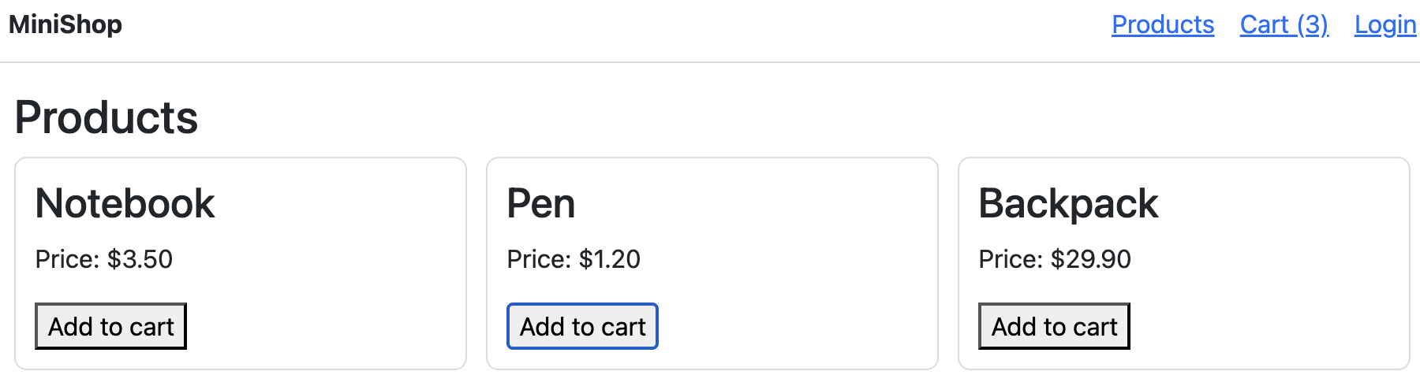
Demo (1)
Visit the MiniShop website, e.g., http://localhost:5173/
It will redirect to /products, which launches ProductsView component (see router/index.js)
You will see the list of products, as ProductsView retrieves the list of products via productsStore and renders it.

Slide 34
Demo (2)
Add some products into the cart by clicking “Add to Cart” button of the products.
  This action essentially updates the cartStore (stores/cart.js).
You will observe that the link “Cart” in navigation bar gets updated with the new product count, e.g., “Cart (3)”, as you add new products.
  This is because the navigation bar (components/NavBar.vue) gets the cart data from the cartStore, which makes it reactive to the changes in the cart store.

Slide 35
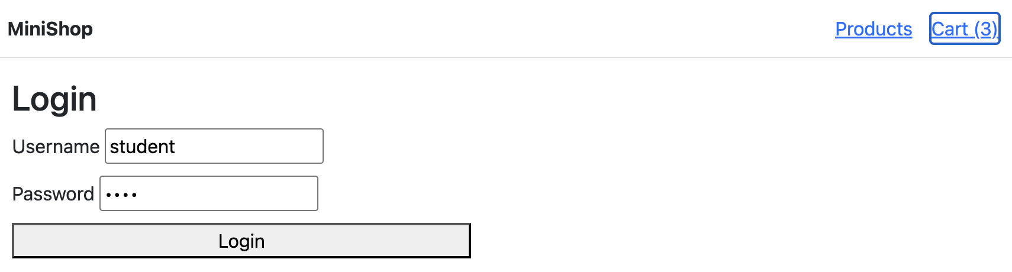
Demo (3)
Then click the “Cart (3)” link in the navigation bar.
This action redirects the user to “Login” page, as the user has not logged in (see the navigation guard in router/index.js).

Slide 36
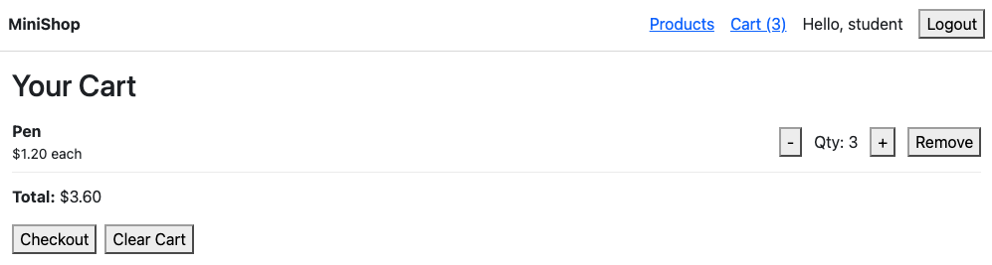
Demo (4)
The Login is a fake functionality with the username “student” and a default password.
You just click “Login”
You will then see the Cart in which you can either ”Checkout” or “Clear Cart”
You can also edit the quantity or remove the item.

Slide 37
Exercises
Let’s extend the MiniShop app in our running example with the following features:
When the user refreshes the page, the cart should remain (items and quantities should not reset).
Add a new route: /products/:id that shows one product’s details.
If the user refreshes, they should stay logged in (token and username persist).
After checkout, create an order and allow the user to view past orders at /orders (protected to only authenticated users).
These exercises will help you practice shared state across routes, route params, using the same store in multiple views, and authentication state management.

Slide 38
Exercise 1
When the user refreshes the page, the cart should remain (items and quantities should not reset).
Part A:
In stores/cart.js, load initial cart from localStorage
  In cart store, when the store is created, initialize items using data from localStorage (if present).
  If nothing is stored, default to an empty array.
Part B:
In stores/cart.js, save cart to localStorage whenever it changes
  Whenever cart items change (add/remove/increase/decrease/clear), update localStorage.

Slide 39
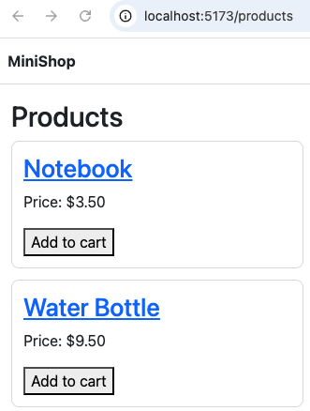
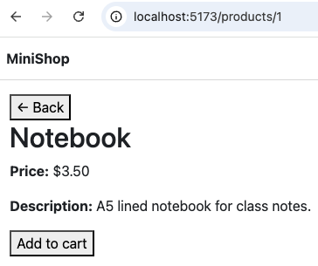
Exercise 2
2. Add a new route: /products/:id that shows one product’s details.
Expected Behavior:
a) When you visit the landing page, the product titles should be displayed as clickable links
b) When you click a link, e.g., Notebook, it should display the product detail of the notebook:

Slide 40
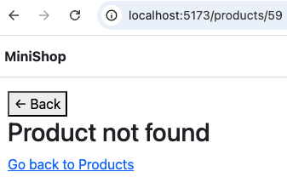
Exercise 2 (continue)
Part A:
In views/, create a new component, ProductDetailView.vue
  Intuitively, this component is to provide a detail view of the product with the given id
The UI should:
show: title, price, and a short description. Hint:
  invoke productsStore.fetchProducts() on mounted
  Use productsStore.products to find the product with the given id
has an “Add to cart” button that uses cartStore’s addToCart(product), which adds the product to the cart
has a “<- Back” link. Clicking on the link should go back to /products page
Error handling
If product id doesn’t exist, show “Product not found” and a link back to /products.
In router/index.js, add a new route that maps to ProductsDetailView.vue component:
{ path: "/products/:id”, component: ProductDetailView }

Slide 41
Exercise 2 (continue)
Part B:
In components/ProductCard.vue, modify code so that product title, e.g., “Notebook”, can be clickable and it leads to ProductDetailView on click

Slide 42
Exercise 3
3. If the user refreshes, they should stay logged in (token and username persist).
Part A: Update stores/auth.js
Persist auth info
  Save { token, username } to localStorage when login succeeds.
  Use a localStorage key
Load auth info on startup
  When the auth store is created, if localStorage has saved auth info:
    restore token and user
    auth.isLoggedIn should become true automatically.
Part B: Update stores/auth.js
Logout must clear saved state
  Update logout() action to also remove the localStorage key.
Part C: Update views/LoginView.vue
In LoginView, if the user is already logged in, redirect them to /products immediately.

Slide 43
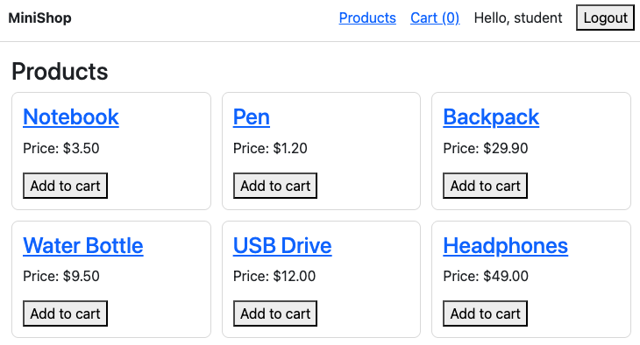
Exercise 3 (continue)
3. If the user refreshes, they should stay logged in (token and username persist).
If implemented correctly, visiting the website again, after having logged in previously, should show the user authentication status (“Hello, student”)

Slide 44
Exercise 4
4. After checkout, create an order and allow the user to view past orders at /orders (protected API).
Part A:
Create a new orders store (orders.js) with action: fetchOrders(token)
  fetchOrders method receives the user authentication token as input
  It then sends a GET request to the backend to fetch the user’s order history
  Use provided Backend API:
    GET /orders
    Provide authentication token in config parameter, e.g.,
    await axios.get("http://localhost:8000/orders", {
    headers: {
    "Authorization": `Bearer ${token}`
    }
    })
Check out this video for the expected app behavior
See the PostMan screenshot in nextslide for detail about this API

Slide 45
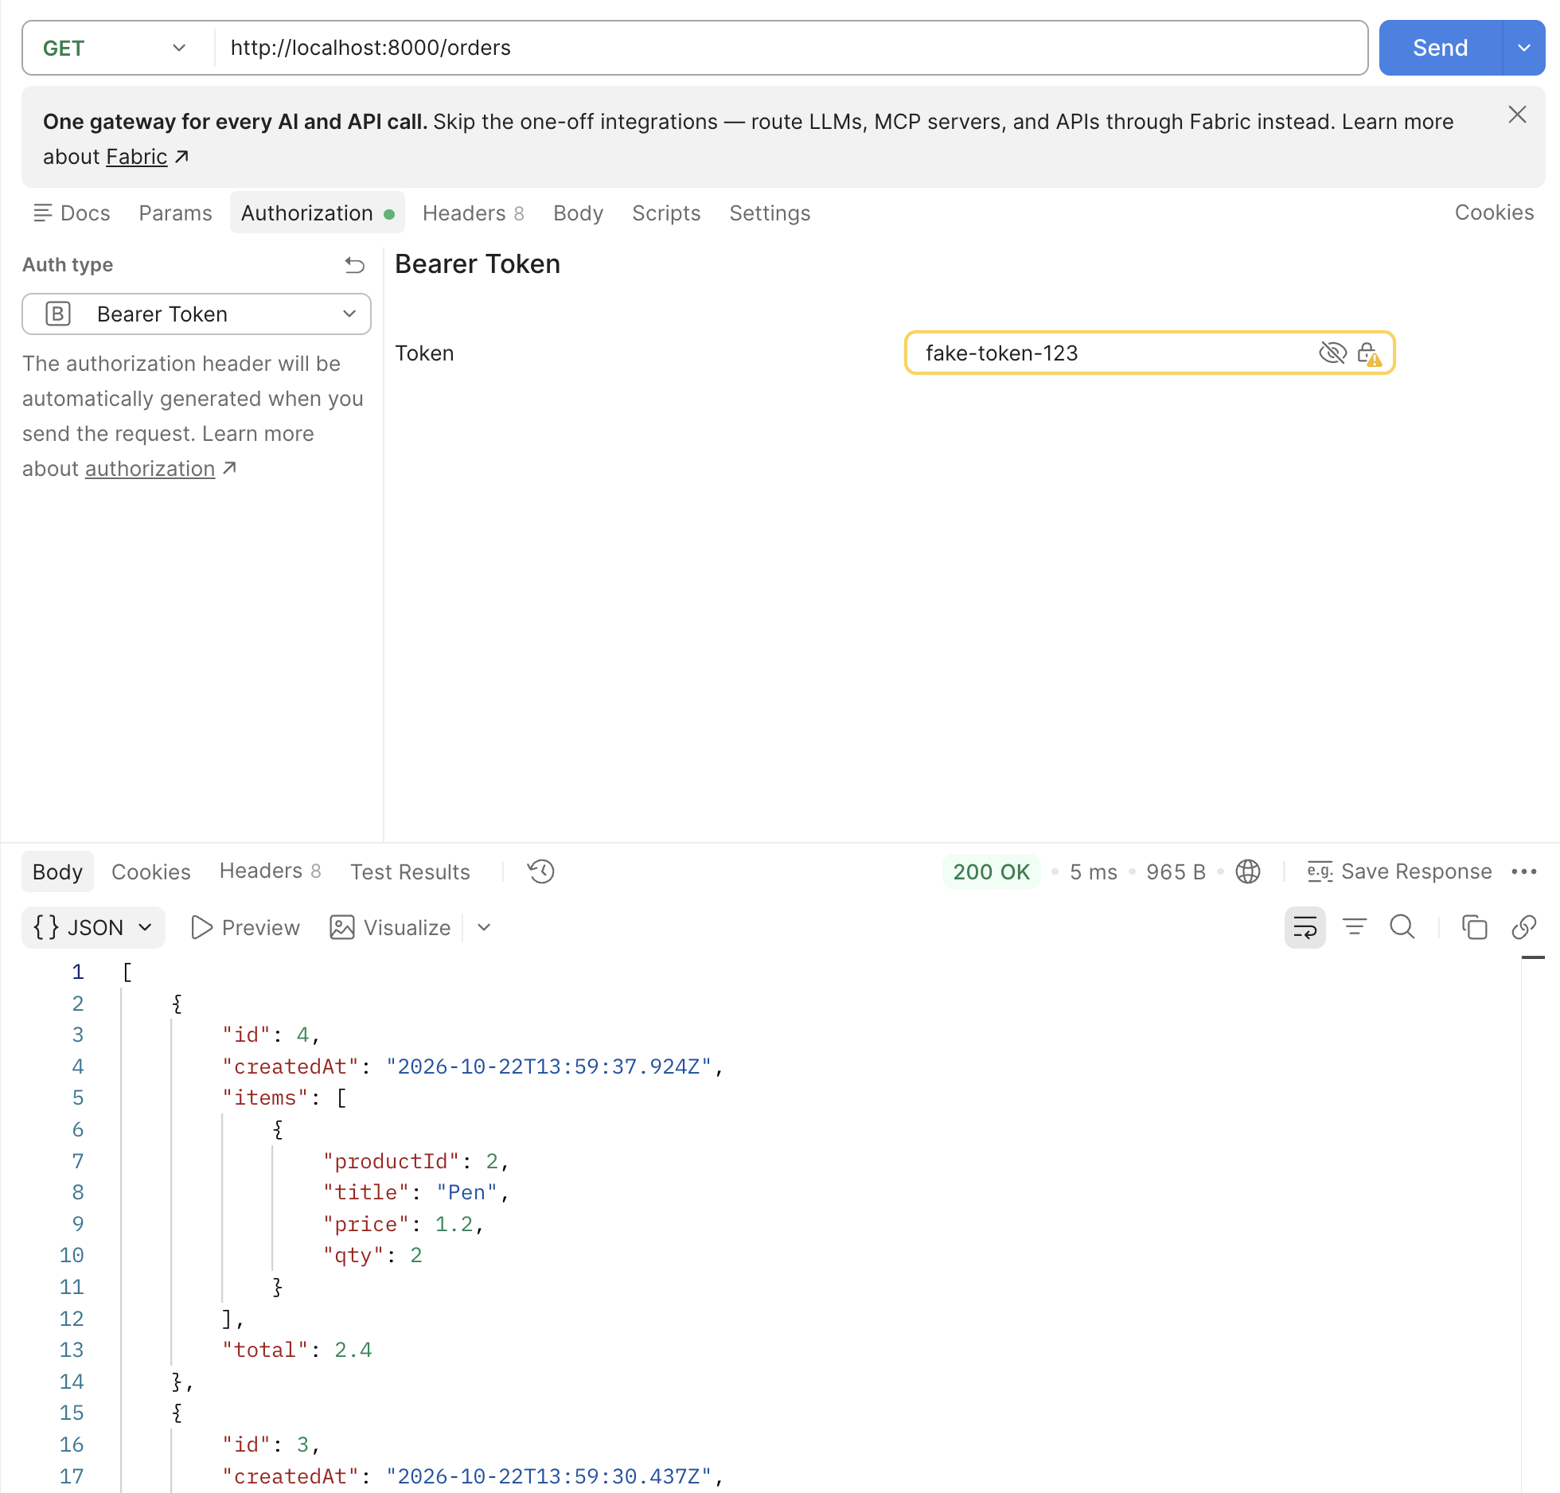
Exercise 4
/orders API

Slide 46
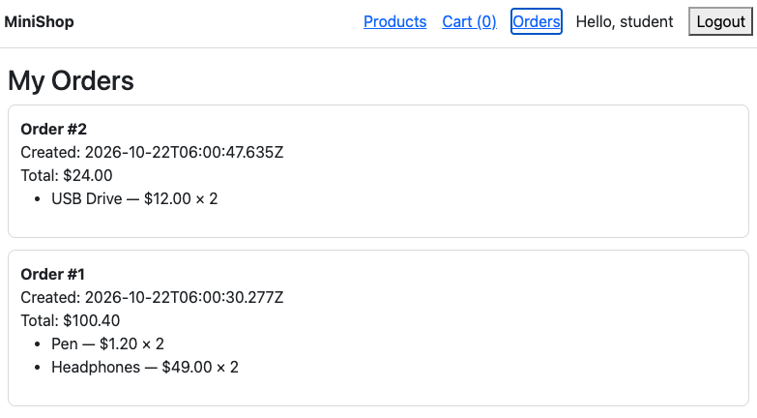
Exercise 4
4. After checkout, create an order and allow the user to view past orders at /orders (protected API).
Part B:
Create a new view: views/OrdersView.vue
  This component should display the user’s order history, using the orders store created in Part A
Check out this video for the expected app behavior

Slide 47
Exercise 4
4. After checkout, create an order and allow the user to view past orders at /orders (protected API).
Part C:
Update router/index.js to add /orders route
  This component should display the user’s order history, using the orders store created in Part B
  The route should be protected, i.e., only authenticated user (similar to protecting /cart route)
Part D:
Update NavBar to include Orders link
In components/NavBar.vue, add the link to the new /orders route created in Part C
Check out this video for the expected app behavior

Slide 48
Take Away Message
State management solves shared-data problems in SPAs: when multiple components/pages need the same data (e.g., cart count, user session, product list), using a store avoids prop drilling and keeps the app easier to maintain.
Pinia provides a clean structure for app-level logic: use state for shared reactive data, getters for derived/computed values (e.g., total price), and actions for business logic and async API calls.
Stores integrate naturally with routing: views can fetch data on onMounted(), reuse cached store data across routes, and reactively update the UI everywhere (Navbar, pages, components) whenever store state changes.
Route guards control navigation based on store state: use route meta flags (e.g., requiresAuth, requiresRole) with router.beforeEach() to protect routes and apply the “redirect back after login” pattern.
Good UX requires handling real-world situations: manage loading/error states, persist key state when needed (cart/auth via localStorage), and remember that guards are for UX—backend APIs must still enforce authentication/authorization.

